Slide 1
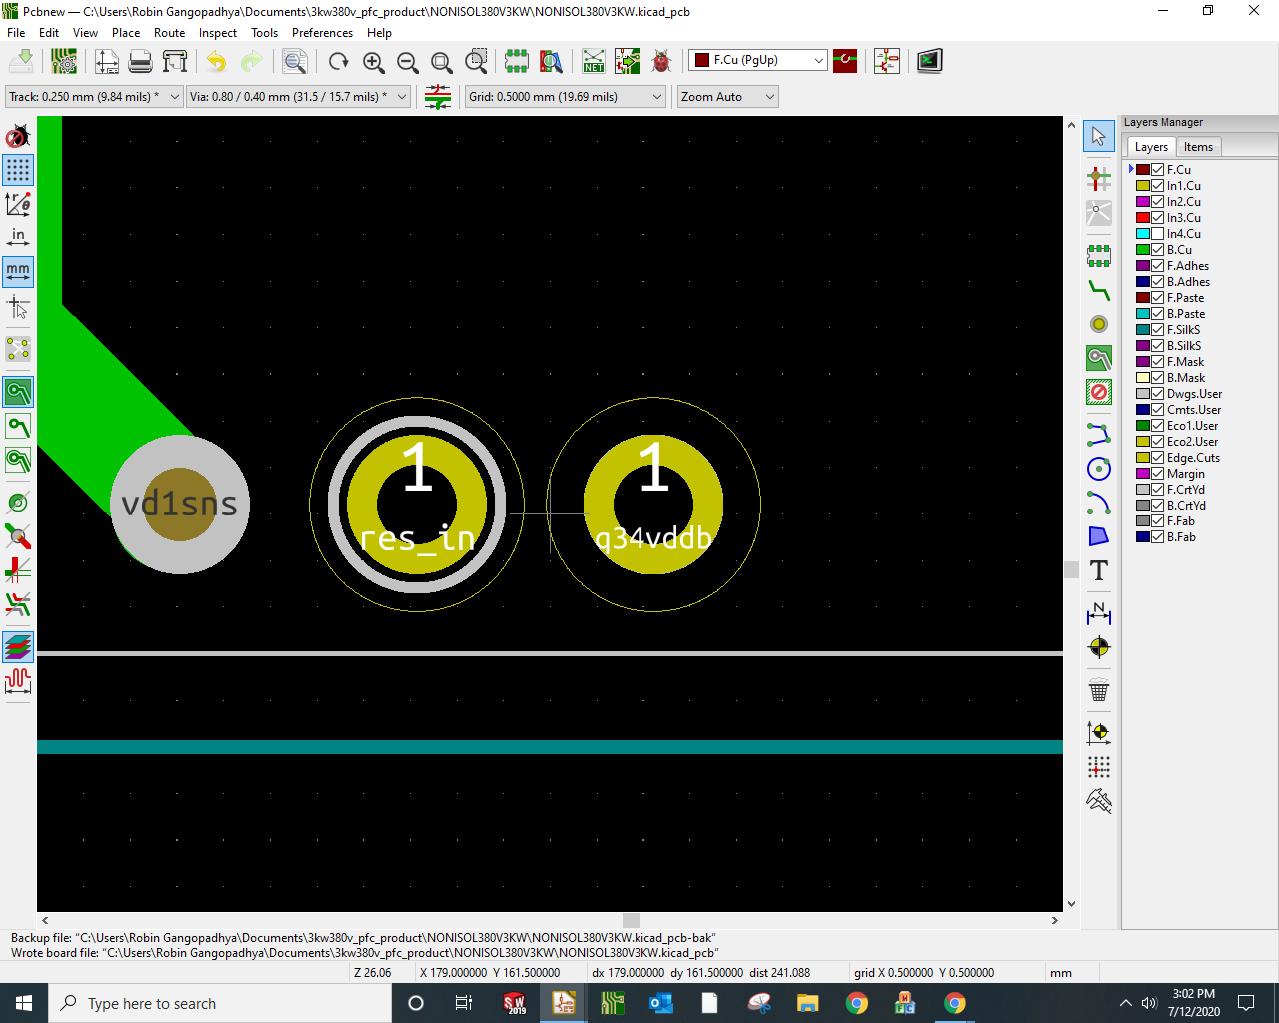
OUTER BOUNDARY OF PIN FOOTPRINT
Why is it there?
How to remove it when not needed or when it is undesirable?

